Slide 1
High Level Business Entity for CDM
Party
Non-Party
Office
Organization
Party Group
Person
Plan
Territory
Trading

Slide 2
CDM Subject Areas
Party
Territory
Party Role
Party Role Relationship
Party Registration
Party Classification
Party Distribution Channel
Party Restriction
Party
Party Contact Mechanism
Party External ID
Party Relationship
Party Territory
Party Address
Party Alias
Trading Identity
Plan
Plan External ID
Plan Relation
Plan
Plan Party Role
Plan Investment
Plan Merge

Slide 3
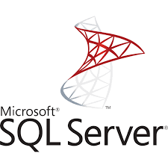
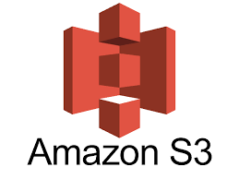
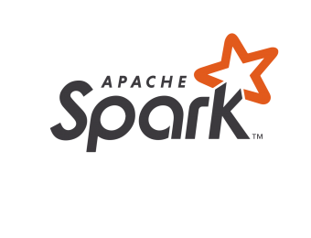


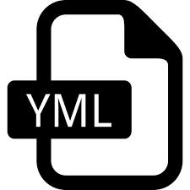
High Level Architecture
Source File
Pre-Land
Staging
MDM-Land
MDM-Hub
Office
WF_1
Office
WF_4
Today_Party
WF_7
CDM
Organization
Organization
C_LDG_Party
WF_2
WF_5
Yesterday_Party
Person
WF_3
Person
WF_6
Current
Proposed
inbound
CDC
CDM
Office
Office_DF
Party_DF
Organization
Today_Party
C_LDG_Party
Organization_DF
Party_DF
Person
Person_DF
Party_DF
Source src1
src_entity Office
tgt_entity Party
src_col1 tgt_col1
src_col2 tgt_col2
Achieve
Previous

Slide 4
Common Ingestion Framework using Configuration file
Office
Office_DF
Party_DF
Party
Organization
Organization_DF
Party_DF
Person
Person_DF
Party_DF
Highlights –
Replacing Pre-Land tables with in-memory data frames.
The joins of multiple pre-land tables to load the today layers will be replaced by joins between data frames
Source src1
src_entity Office
tgt_entity Party
src_col1 tgt_col1
src_col2 tgt_col2

Slide 5
Advantage of Using Common Ingestion Framework
Maintainability -By-passing pre-landing storage reduces approx 30% of inbound Jobs till today later data load.
Extensible – Easy to support dynamic attribute loading by changing the configuration file.
Performance – Eliminating multi hops and in-memory processing improves performance from file to stage layer load at least by 2x.
Less Regression – Keeping source and target stage layer same, regression is limited to stage layer.
Data Lineage – Keeping history data will ease to back track and help in creating dashboard for business needs.

Slide 6
Source to Target Data Loading Framework with CDC
inbound
Office
Office_Party_DF
Tgt_Office_Party_DF
CDC
Final_Office_Party_DF
Organization
Org_Party_DF
Tgt_Org_Party_DF
Final_Org_Party_DF
Party
Pers_Party_DF
Tgt_Pers_Party_DF
Final_Pers_Party_DF
Person
Achieve
previous
Party
Party

Slide 7
Advantage of using Staging Area
Replacing Today as Staging Area for ETL.
Provision to apply data cleansing rule before data is loaded to MDM.
History data is maintained separately on object storage.
Faster data processing using spark cluster.
Source and entity wise code module for isolation.
Less Read/Write from Disk (DB) to Memory, requires less I/O.
In-memory processing of entire dataset.
Option to retain history data for each day on inexpensive object storage that might help in data lineage or any business reports

Slide 8
Comparison between Automation Tool & Manual Conversion
Automation Tool (Any) | Manual Conversion
Design is fixed, source and target structure cannot be changed. | Design is flexible. No dependency on existing architecture.
Just replace each data operation (transformation) with target language of choice but never merge those operations. | Better control over the logic to consolidate multiple transformation in a single query.
Too many temporary data objects are created leads to complicacies. | Cleaner approach as most of transformation are moved to SQL engine.
Don’t have the facility to ignore redundant codebase. | Flexible design.
Manual effort is less, quick turn around time. | More time to develop a piece of code.
Since no change in framework lesser amount of regression is required. | More regression is required.

Slide 9
Informatica Mapping Conversion Efficiency Comparison
Informatica
Source Qualifier
Expression
Filter
Router
Target
Pyspark using Dataswitch
Source File
DF_SQ
DF_EXP
DF_FLT
DF_RTR1
DF_RTR2
Target
Source Table
Pyspark Manual
SQL
Select…..
Case When
From Left Join
Where
UNION
DF_Src
DF_Tgt
Target

